Slide 1
PPM
Follow us on :

Slide 2
About StrategicERP
StrategicERP is into the business of developing ERP solutions specifically designed for Real Estate and Infrastructure industry.
StrategicERP is a web based application built by IITians on proprietary J2FX framework.
It is a single window solution to automate all the business transactions, it ensures optimum utilization of resources and efficient business process management to keep in pace with the time.
StrategicERP has 500+ clients across India, some of our esteemed clients consist of : GDCL, Raj Infra, Vishal Infra, Hirannandani Group, Poddar Housing, Paradise Group, TVH Group, Puranik Builders, Transcon Group, Kundan Spaces, M.V. Omni Projects, Rajesh Life Spaces, DS-MAX Properties, Hombale Group, A. Shridhar and many more.

Slide 3
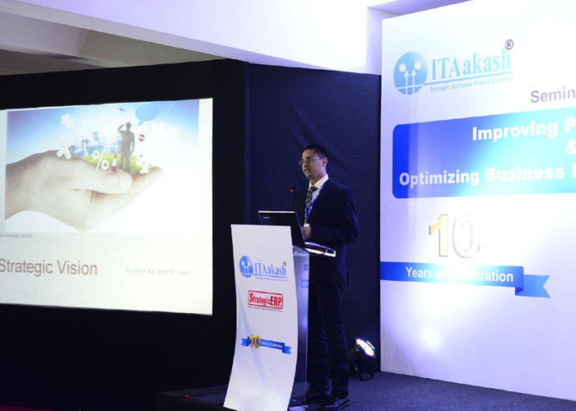
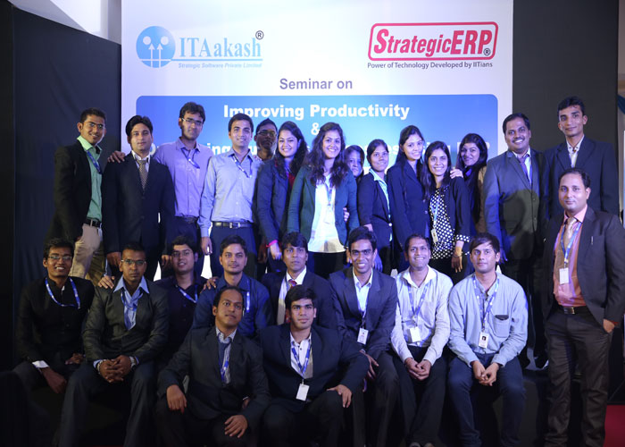
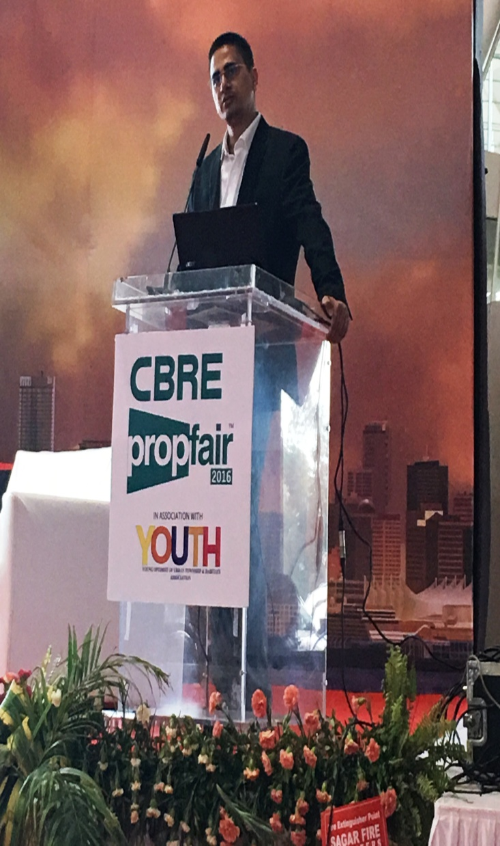
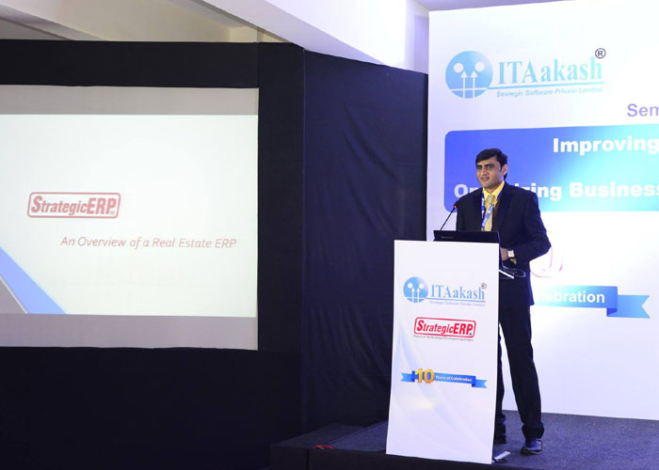
StrategicERP Moments

Slide 4
What is PPM ?
It is our pride to announce that StrategicERP has come up with a new version of our ERP known as “Project Portfolio Management” for SME Infrastructure Industries. PPM is a cost effective and flexible web based ERP solution.
It is a best fit for companies implementing ERP solutions for the first time with limited no. of users. Project Portfolio Management offers Comprehensive Functionality of WBS Estimations, Planning, Scheduling, Execution Control & Review. Highly Intuitive MIS Reports and Dashboards help in driving Projects effectively. Project Portfolio Management provides seamless integration with Tally. ( If Required ) Project Portfolio Management is Compatible with OS: Windows, Linux, Mac and has no browser/device dependability .

Slide 5
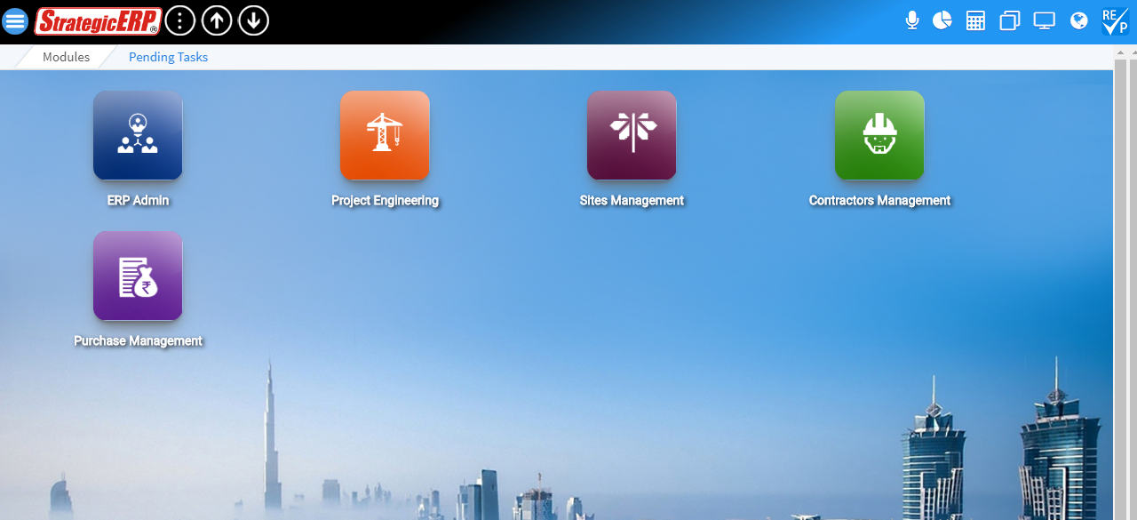
Project Portfolio Management Menu Screen - Modules

Slide 6
Advance Features
Mail Conversation
Voice Command
Dashboards
Calculator
Multiple Tab
Background Option
Multiple Language
User Profile
AI and Machine Learning Technology
ERP User Chat

Slide 7
Voice Search – Conversational User Interface for Instant Details

Slide 8
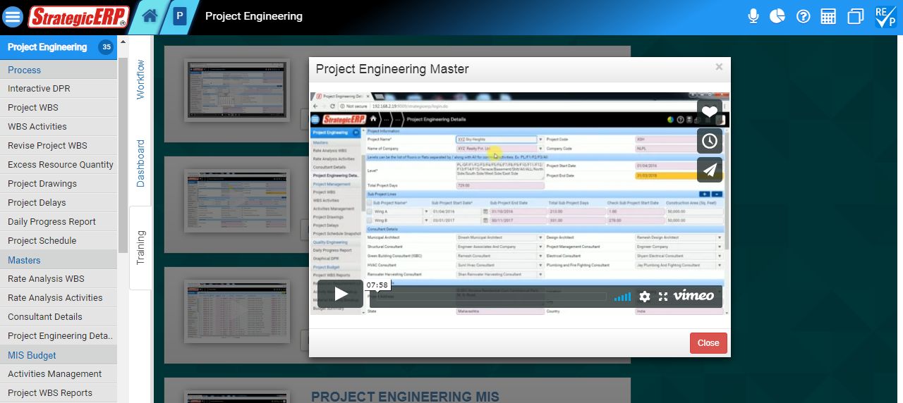
Video Tutorials – Easy to Learn with Online Tutorials.

Slide 9
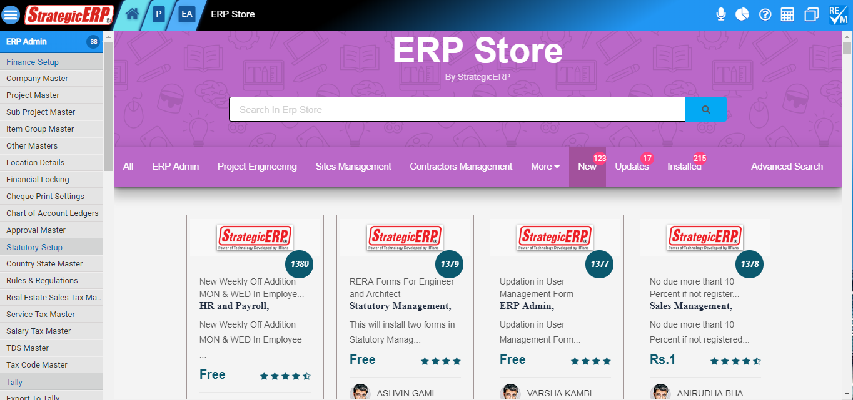
ERP Store – To Install and Update new Developments.

Slide 10
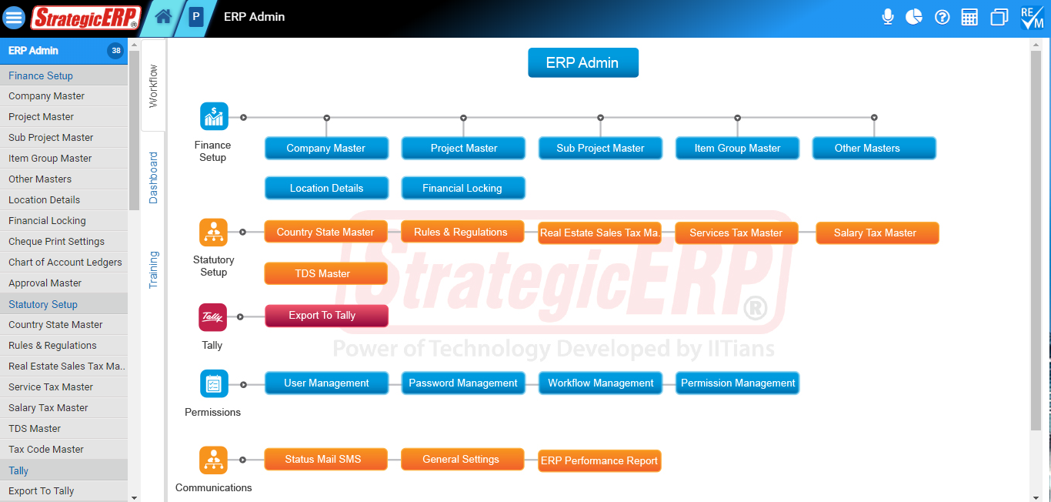
PPM Module Flow | ERP Admin
ERP Admin

Slide 11
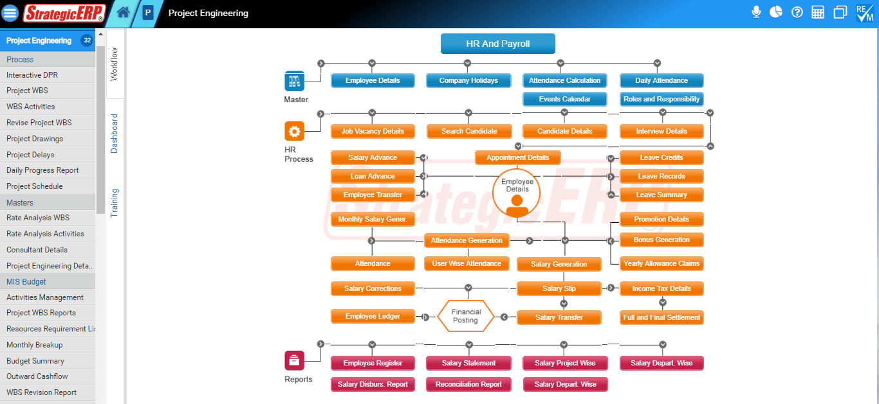
PPM Module Flow | Project Engineering
Project
Engineering
Can Manage
Project Activities,
Project Drawings,
Project Delays,
Graphical DPR,
Activity Material and
Labour Monthly Breakup,
Budget Summary,
Outward Cashflow.

Slide 12
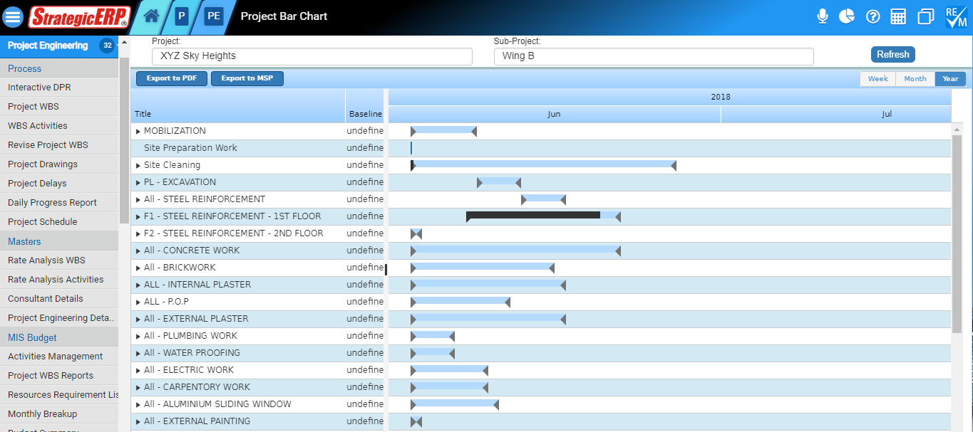
MIS Reports | Project Engineering
Project Bar Chart
Other Critical
MIS Reports
* Snapshot Bar Chart
* Engineering Report
* Daily Labour Report
* Thumb Rule Report
* Abstract Summary
* Material Reconciliation

Slide 13
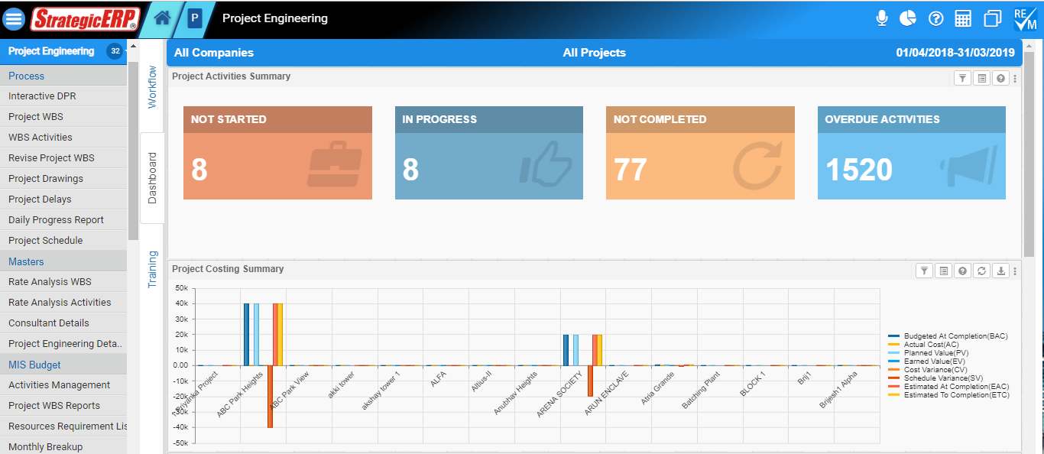
Dashboard Reports | Project Engineering
Project Activity
Summary
Other Critical
MIS Reports
Level Wise Costing
Summary
Month Wise Costing Summary
EAC Vs AC Vs ETC

Slide 14
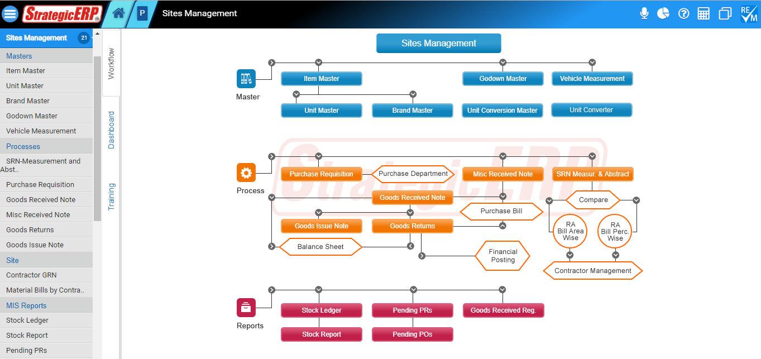
PPM Module Flow | Sites Management
Sites
Management
Can Manage
SRN – Measurement and
Abstract,
Purchase Requisition,
Goods Received Notes,

Slide 15
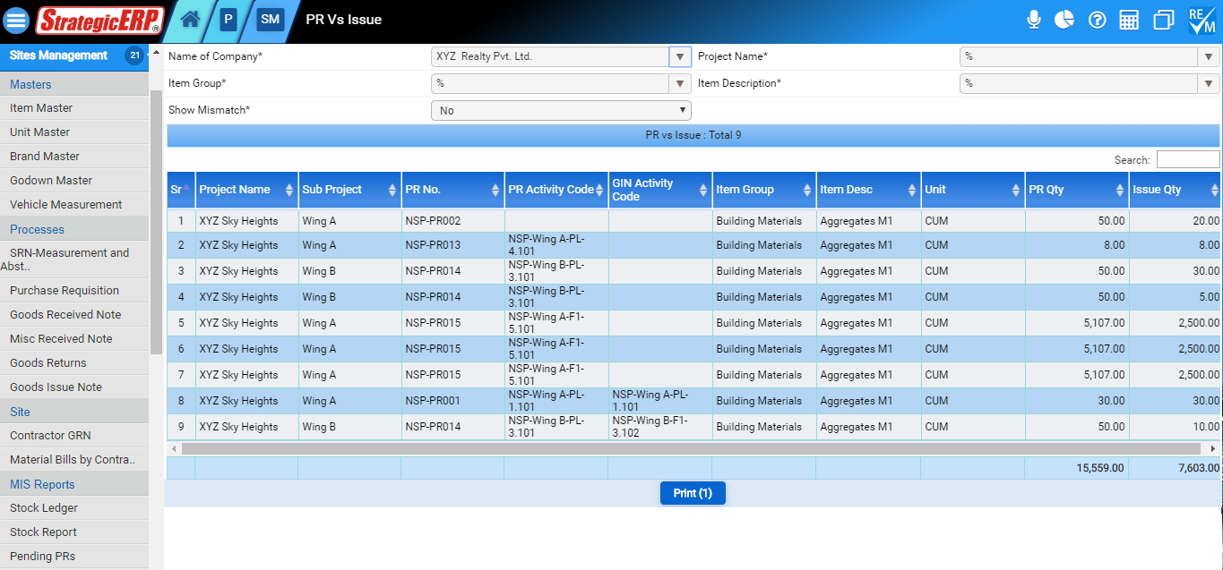
MIS Reports | Sites Management
PR vs Issue
Other Critical
MIS Reports
* Stock Ledger
* Stock Report
* Pending PRs
* Pending Pos for GRN
* Goods Received Register

Slide 16
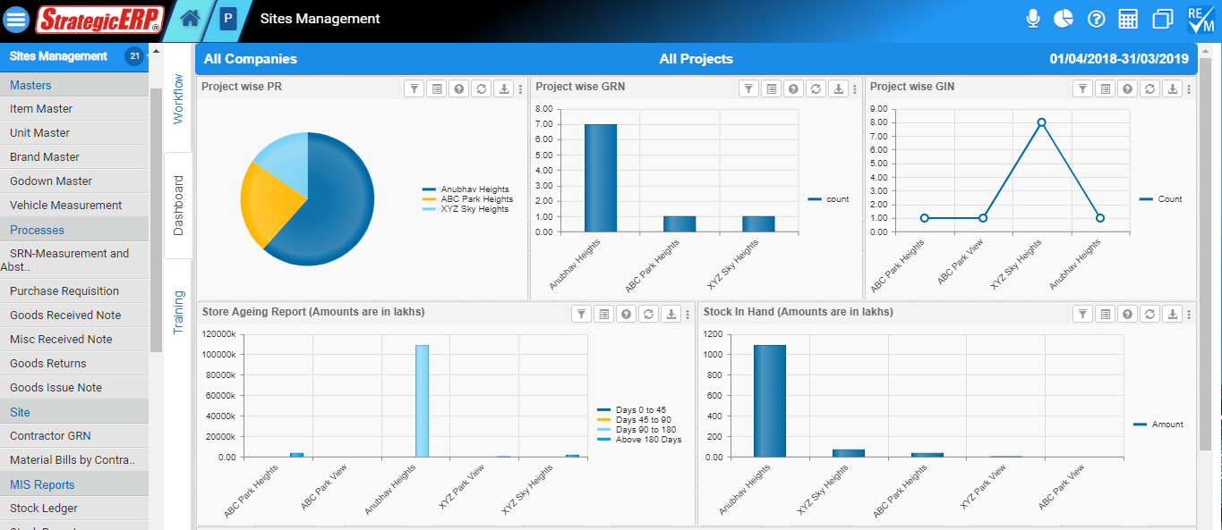
Dashboard Reports | Sites Management
Project Wise PR
Other Critical
Reports
Store Aging Report
Stock in Hand
Stock Aging Report

Slide 17
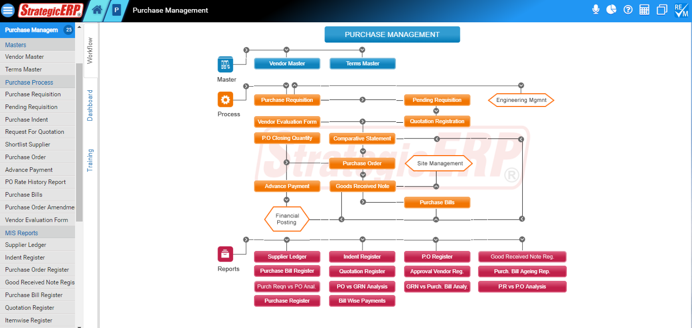
PPM Module Flow | Purchase Management
Purchase
Management
Can Manage
Purchase Requisition,
Pending Requisition,
Comparative Statement,
Shortlist Vendor,
Purchase Order ,
Advance Payment,
P.O Closing Quantity
Vendor Evaluation.

Slide 18
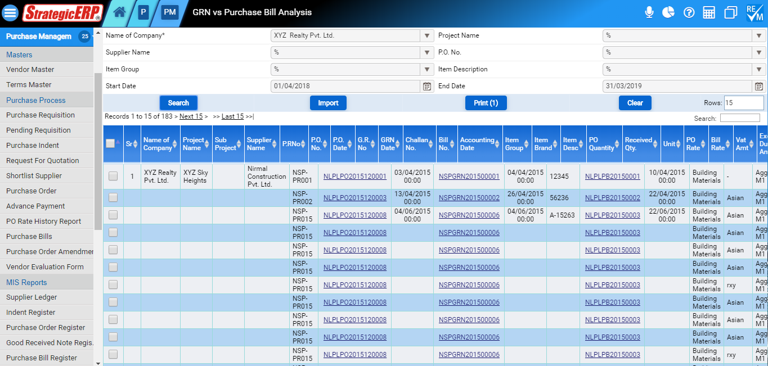
MIS Reports | Purchase Management
GRN vs Purchase Bill
Analysis
Other Critical
MIS Reports
* Supplier Ledger
* Indent Register
* PO Register
* PO vs GRN Analysis
* PR vs PO vs GRN vs PB
Analysis

Slide 19
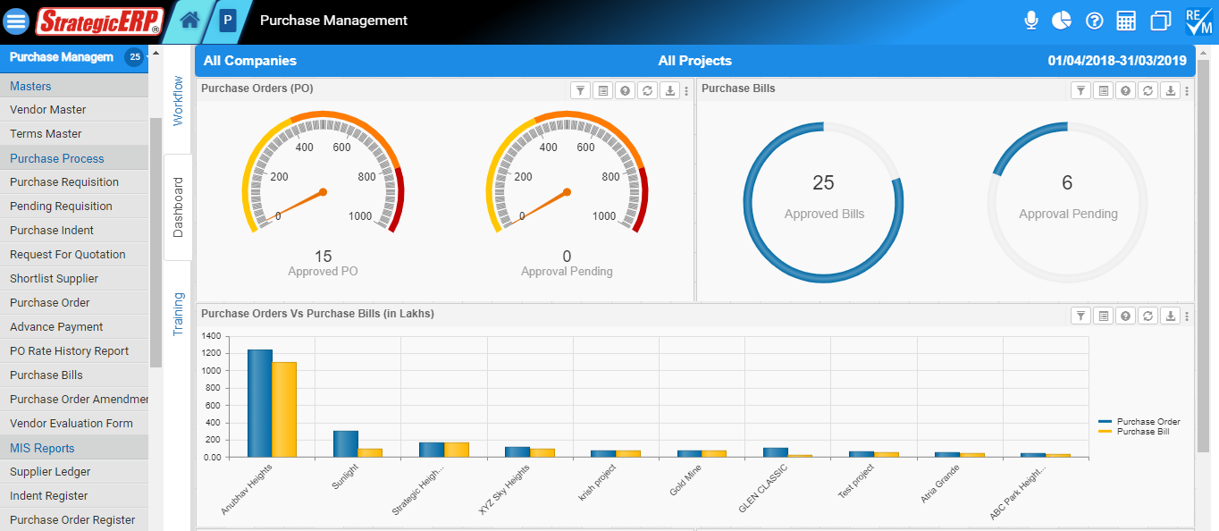
Dashboard Reports | Purchase Management
Purchase Order
Other Critical
Report
Project Wise Purchase

Slide 20
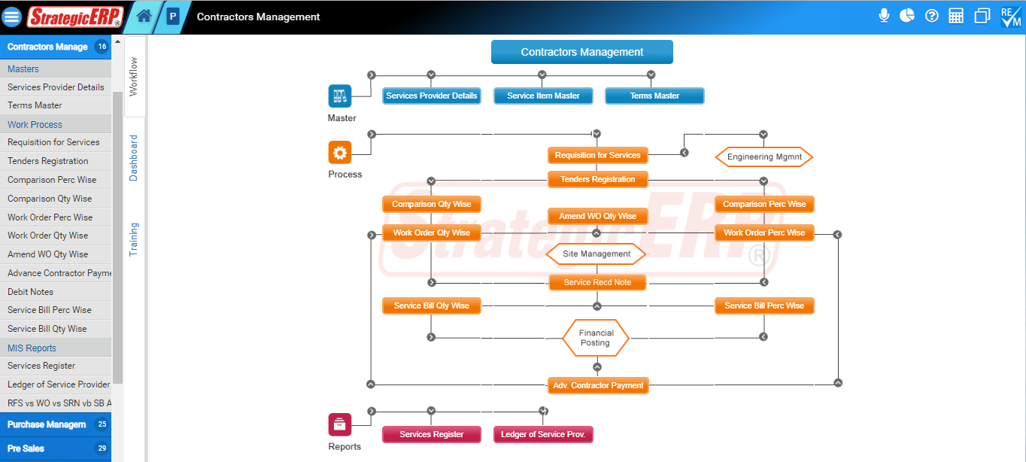
PPM Module Flow | Contractors Management
Contractors
Management
Can Manage
Requisition for Services,
Tender Registration,
Comparison Perc and
Qty Wise,
Work Order Perc and
Qty Wise,
Amend WO Qty Wise,
Service Bill Perc and
Qty Wise,

Slide 21
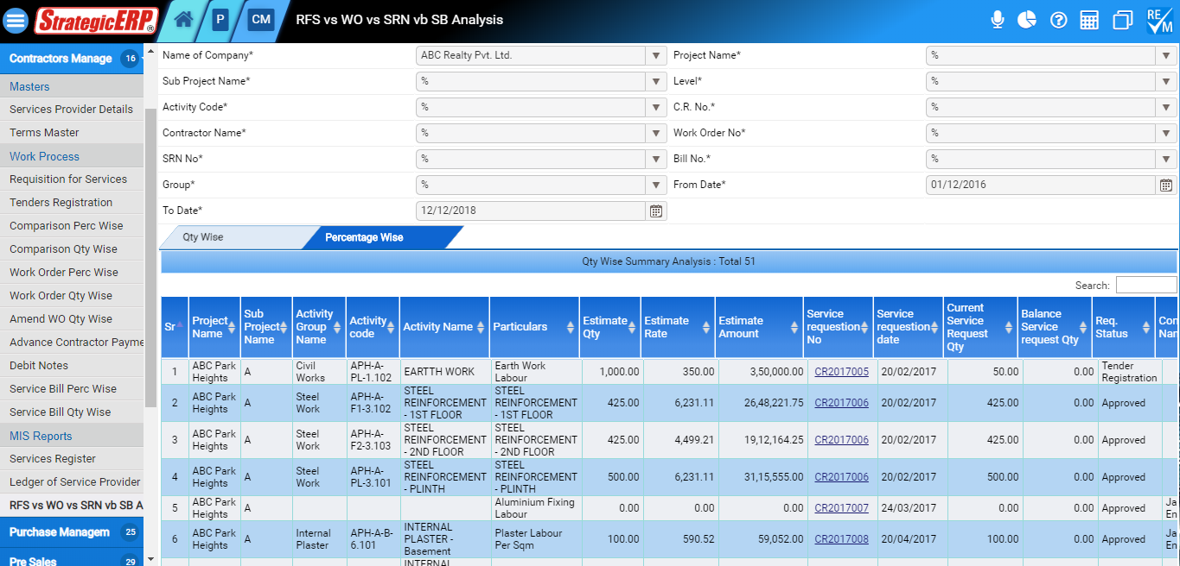
MIS Reports | Contractors Management
RFS vs. WO vs. SRN vs.
SB Analysis
Other MIS Reports
Services Register
Ledger of Service
Provider

Slide 22
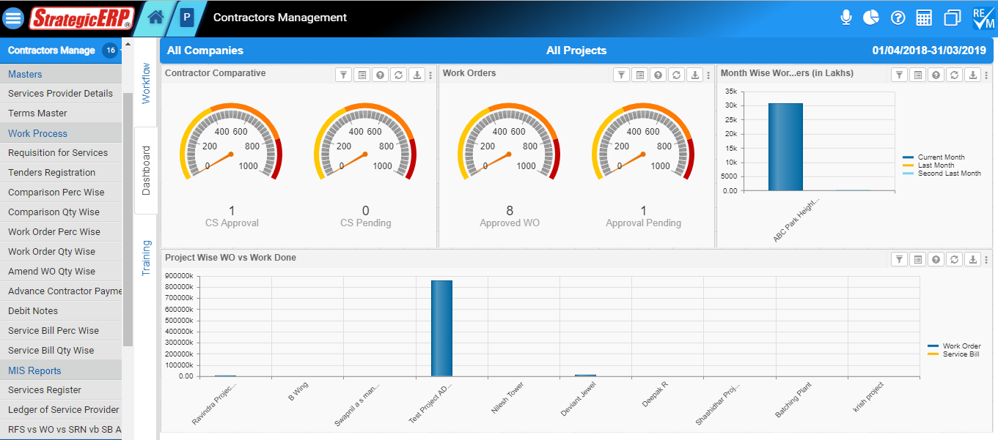
Dashboard Reports | Contractors Management
Contractors Comparative
Other Report
Project Wise WO vs
Work Done
Month Wise Work
Orders

Slide 23
PPM – Add-on’s Module
Tally Integration
IVR Integration
Email Configuration
Click to call
SMS Configuration
Mobile ERP App
Exhibition Integration
Customer App
Website Integration
Partner App

Slide 24
MobileERP App
Available On :
Access ERP on Mobile – Anytime , Anywhere

Slide 25
| Customer Base
500+
customers
Mumbai
Across
PAN India
Mumbai
Pune
Bangalore
Ahmedabad
Delhi
Serving
Verticals
Real Estate
Infrastructure
Manufacturing

Slide 27
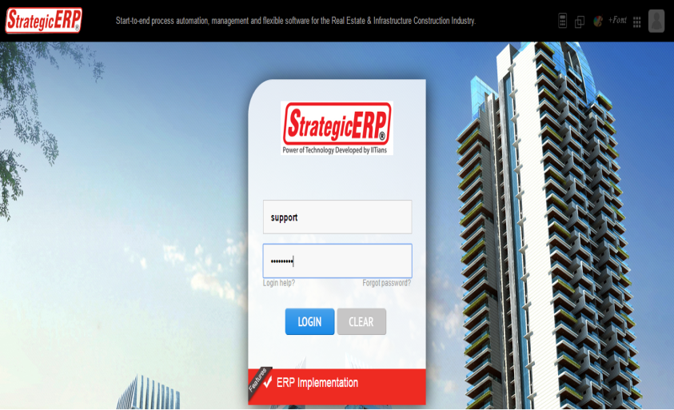
Technical Support
StrategicERP Support Portal
http://strategicerpcloud.com/crm/
Username : support
Password : xyz
support@strategicerp.cpm
+91-22-25750104/5/6

Slide 28
Contact Us
MUMBAI (CORPORATE OFFICE)
ITAakash Strategic Software (P) Ltd,
5th floor, D S Business Galleria,
Near Huma Adlabs,
Beside Toyo House,
L.B.S. Road, Kanjur Marg (W),
Mumbai, 400078 INDIA.
+91-22-25770088/25750101
enquiry@strategicerp.com

